Slide 1
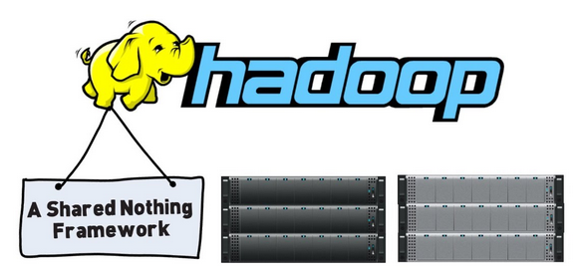
Cloud Programming and Software Environments
Map Reduce and Hadoop
Adapted from Kai Hwang, University of Southern California with additions from Matei Zaharia, EECS, UC Berkeley

Slide 2
Overview
Process flow in MapReduce
Motivation for Programming Paradigm
MapReduce
MapReduce Operational Steps
Twister : Iterative MapReduce
Hadoop
HDFS Architecture
Read and Write Operations in HDFS
MapReduce Architecture in Hadoop
Running a job in Hadoop
Challenges

Slide 3
Parallel Computing and Programming Paradigms Process Flow in MapReduce
Partitioning
Computation Partitioning: This splits a given job or a program into smaller tasks. Partitioning greatly depends on correctly identifying portions of the job or program that can be performed concurrently.
Data Partitioning: This splits the input or intermediate data into smaller pieces.
Mapping (Resource Allocator): This process aims to appropriately assign smaller parts of data and pieces of program to be run simultaneously on different workers and is usually handled by resource allocators in the system
Synchronization: Because different workers may perform different tasks, synchronization and coordination among workers is necessary so that race conditions are prevented and data dependency among different workers is properly managed
Communication: Because data dependency is one of the main reasons for communication among workers, communication is always triggered when the intermediate data is sent to workers
Scheduling (Resource Allocator and Scheduler): For a job or program, when the number of computation parts (tasks) or data pieces is more than the number of available workers, a scheduler selects a sequence of tasks or data pieces to be assigned to the workers.

Slide 4
Motivation for Programming Paradigm
To improve productivity for programmers
To decrease programs time to market
To leverage underlying resources more efficiently
To increase system throughput
To support higher levels of abstraction
MapReduce, Hadoop and Dryad are parallel and distributed programming models.

Slide 5
What is MapReduce?
Simple data-parallel programming model
For large-scale data processing
Exploits large set of commodity computers
Executes process in distributed manner
Offers high availability
Pioneered by Google
Processes 20 petabytes of data per day
Popularized by open-source Hadoop project
Used at Yahoo!, Facebook, Amazon, …

Slide 6
What is MapReduce used for?
At Google:
Index construction for Google Search
Article clustering for Google News
Statistical machine translation
At Yahoo!:
“Web map” powering Yahoo! Search
Spam detection for Yahoo! Mail
At Facebook:
Data mining
Ad optimization
Spam detection

Slide 7
Motivation: Large Scale Data Processing
Many tasks composed of processing lots of data to produce lots of other data
Want to use hundreds or thousands of CPUs ... but this needs to be easy!
Map Reduce provides
User-defined functions
Automatic parallelization and distribution
Fault-tolerance
I/O scheduling
Status and monitoring

Slide 8
What is MapReduce used for?
In research:
Astronomical image analysis (Washington)
Bioinformatics (Maryland)
Analyzing Wikipedia conflicts (PARC)
Natural language processing (CMU)
Particle physics (Nebraska)
Ocean climate simulation (Washington)
<Your application here>

Slide 9
Map Reduce Architecture
Master node
user
Job tracker
Slave node 1
Slave node 2
Slave node N
Task tracker
Task tracker
Task tracker
Workers
Workers
Workers

Slide 10
Map+Reduce
Map:
Accepts input key/value pair
Emits intermediate key/value pair
Reduce :
Accepts intermediate key/value* pair
Emits output key/value pair
R
E
D
U
C
E
Very
big
data
M
A
P
Partitioning
Function
Result

Slide 11
Functions in the Model
Map
Process a key/value pair to generate intermediate key/value pairs
Reduce
Merge all intermediate values associated with the same key
Partition
By default : hash(key) mod R
Well balanced

Slide 12
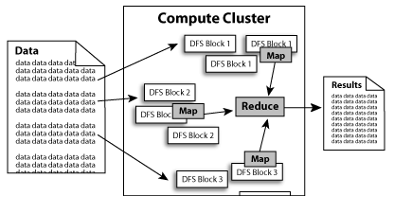

Slide 13
MapReduce
Cat
Bat
Dog
Other
Words
(size:
TByte)
combine
reduce
map
part0
split
reduce
combine
split
map
part1
combine
reduce
split
map
part2
split
map

Slide 14
A Simple Example
Counting words in a large set of documents
map(string value)‏
//key: document name
//value: document contents
for each word w in value
EmitIntermediate(w, “1”);
reduce(string key, iterator values)‏
//key: word
//values: list of counts
int results = 0;
for each v in values
result += ParseInt(v);
Emit(AsString(result));
The map function emits each word w plus an associated count of occurrences (just a “1” is recorded in this pseudo-code)
The reduce function sums together all counts emitted for a particular word

Slide 15
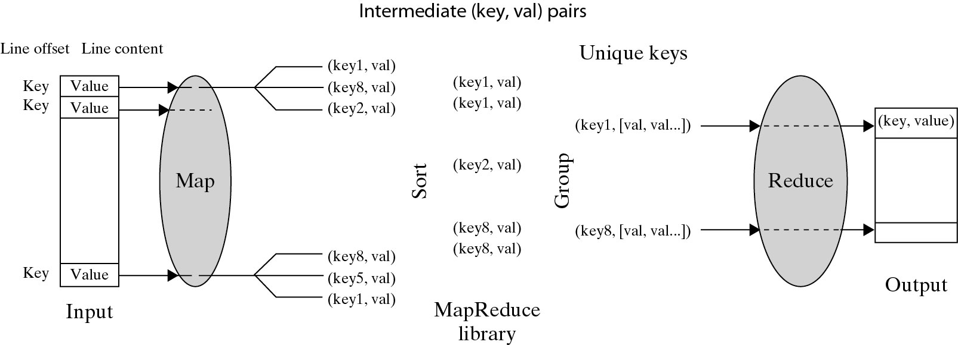
Logical Data Flow in 5 Processing Steps in MapReduce Process
(Key, Value) Pairs are generated by the Map function over multiple available Map Workers (VM instances). These pairs are then sorted and group based on key ordering. Different key-groups are then processed by multiple Reduce Workers in parallel.
Notes:
Cloud applications are the key global opportunity for developers during next four years
2009: $8.5 billion
2013: $16.8 billion

Slide 16
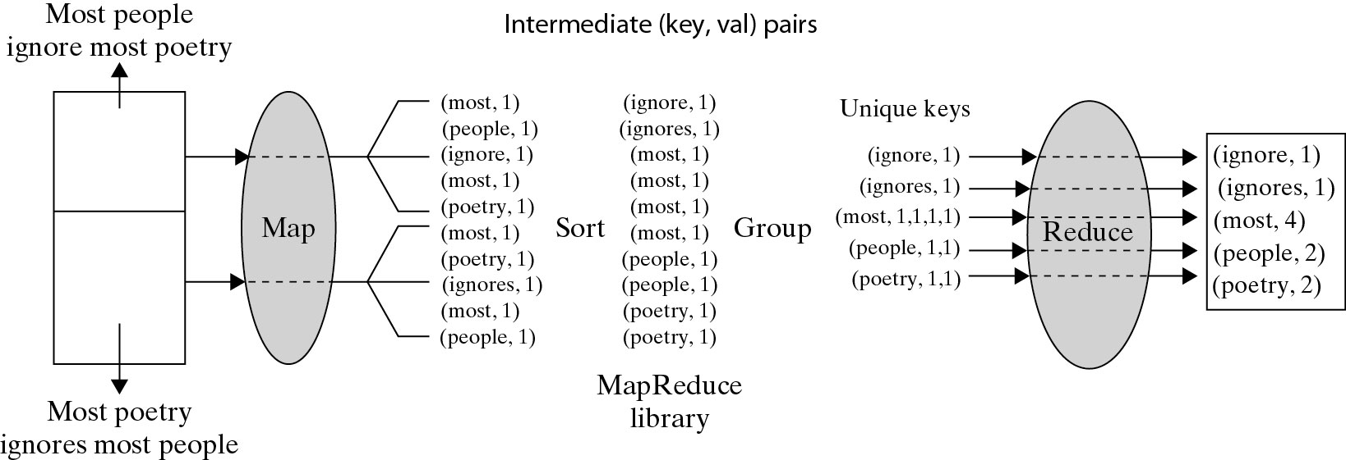
A Word Counting Example on <Key, Count> Distribution
Notes:
Cloud applications are the key global opportunity for developers during next four years
2009: $8.5 billion
2013: $16.8 billion

Slide 17
Actual MapReduce Data and Control Flow
Data Partitioning
Computation Partitioning
Determining Master and workers
Reading Input data (Data Distribution)
Map Function
Combiner Function
Partitioning Function
Synchronization
Communication
Sorting and Grouping
Reduce Function
Mapper
Reducer

Slide 18
Actual MapReduce Data and Control Flow
Data Partitioning: The MapReduce library splits the input data (files), already stored in GFS, into M pieces that also correspond to the number of map tasks.
Computation Partitioning: MapReduce library only generates copies of a user program (e.g., by a fork system call) containing the Map and the Reduce functions, distributes them, and starts them up on a number of available computation engines.
Determining Master and workers: The MapReduce architecture is based on a master-worker model. Therefore, one of the copies of the user program becomes the master and the rest become workers. The master picks idle workers, and assigns the map and reduce tasks to them.

Slide 19
Actual MapReduce Data and Control Flow
Mapper Functions
Reading Input data (Data Distribution) : Each map worker reads its corresponding portion of the input data split and sends it to its Map function
Map Function : Each Map function receives the input data split as a set of (key, value) pairs to process and produce the intermediated (key, value) pairs.
Combiner Function: The Combiner function merges the local data of each map worker before sending it over the network to effectively reduce its communication costs
Partitioning Function : The intermediate (key, value) pairs with identical keys are grouped together because all values inside each group should be processed by only one Reduce function to generate the final result. Intermediate (key, value) pairs are partitioned into R regions, equal to the number of reduce tasks by Partitioning Function. A Partitioning function could simply be a hash function (e.g., Hash(key) mod R) that forwards the data into particular regions.

Slide 20
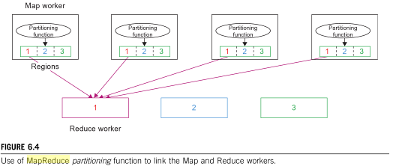
MapReduce Partitioning Function

Slide 21
Actual MapReduce Data and Control Flow
Synchronization: MapReduce applies a simple synchronization policy to coordinate map workers with reduce workers, in which the communication between them starts only when all map tasks finish.
Communication: Reduce worker i, already notified of the location of region i of all map workers, uses a remote procedure call to read the data from the respective region of all map workers.
Reduce Function
Sorting and Grouping: Reduce worker groups intermediate (key, value) pairs by sorting the data based on their keys, followed by grouping all occurrences of identical keys.
Reduce Function: The reduce worker iterates over the grouped (key, value) pairs, and for each unique key, it sends the key and corresponding values to the Reduce function. Reduce function processes its input data and stores the output results in predetermined files in the user’s program.

Slide 22
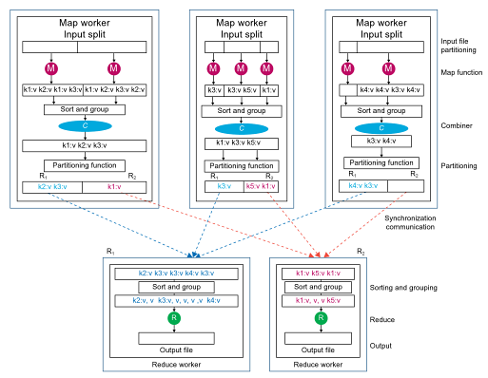
Data Flow of MapReduce
Notes:
Cloud applications are the key global opportunity for developers during next four years
2009: $8.5 billion
2013: $16.8 billion

Slide 23
Points need to be emphasized
No reduce can begin until map is complete
Master must communicate locations of intermediate files
Tasks scheduled based on location of data
If map worker fails any time before reduce finishes, task must be completely re-run
MapReduce library does most of the hard work for us!

Slide 24
Locality issue
Master scheduling policy
Asks GFS for locations of replicas of input file blocks
Map tasks typically split into 64MB (== GFS block size)
Map tasks scheduled so that GFS input block replica are on same machine or same rack
Effect
Thousands of machines read input at local disk speed
Without this, rack switches limit read rate

Slide 25
Fault Tolerance
Reactive way
Worker failure
Heartbeat, Workers are periodically pinged by master
NO response = failed worker
If the processor of a worker fails, the tasks of that worker are reassigned to another worker.
Master failure
Master writes periodic checkpoints
Another master can be started from the last checkpointed state
If eventually the master dies, the job will be aborted

Slide 26
Fault Tolerance
Proactive way (Redundant Execution)
When computation almost done, reschedule in-progress tasks
Whenever either the primary or the backup executions finishes, mark it as completed
The problem of “stragglers” (slow workers)
Other jobs consuming resources on machine
Bad disks with soft errors transfer data very slowly
Weird things: processor caches disabled (!!)

Slide 27
Fault Tolerance
Input error: bad records
Map/Reduce functions sometimes fail for particular inputs
Best solution is to debug & fix, but not always possible
On segment fault
Send UDP packet to master from signal handler
Include sequence number of record being processed
Skip bad records
If master sees two failures for same record, next worker is told to skip the record

Slide 28



MapReduce Implementations
MapReduce
Cluster,
1, Google
2, Apache Hadoop
Multicore CPU,
Phoenix @ stanford
GPU,
Mars@HKUST

Slide 29
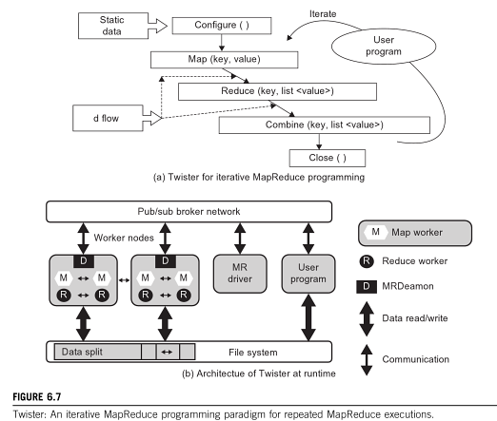
Twister for Iterative MapReduce

Slide 30
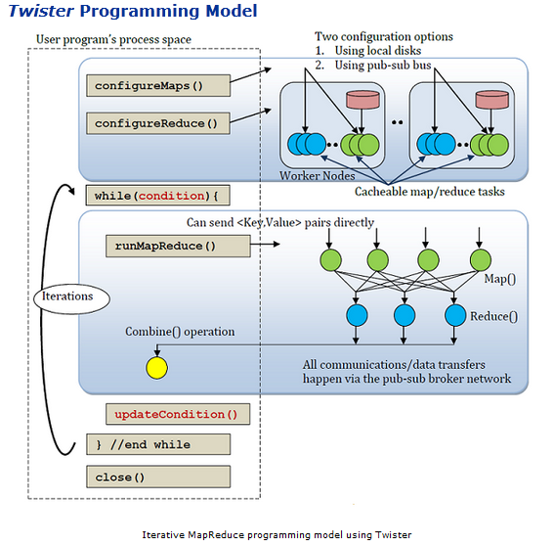
Twister for Iterative MapReduce

Slide 31
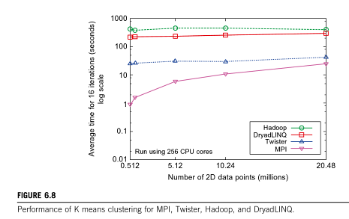
Performance of Parallel Programming Models

Slide 32
Hadoop MapReduce
Hadoop is an open source implementation of MapReduce coded and released in Java by Apache.
Hadoop implementation uses Hadoop Distributed File System.
Hadoop core is divided into two layers.
MapReduce Engine as computation engine
HDFS as data storage manager.
HDFS is inspired by GFS, it organizes files and stores data in distributed computing system.

Slide 33
Hadoop MapReduce
Hadoop : software platform originally developed by Yahoo enabling users to write and run applications over vast distributed data.
Attractive Features in Hadoop :
Scalable : can easily scale to store and process petabytes of data in the Web space
Economical : An open-source MapReduce minimizes the overheads in task spawning and massive data communication.
Efficient: Processing data with high-degree of parallelism across a large number of commodity nodes
Reliable : Automatically maintains multiple copies of data to facilitate redeployment of computing tasks on failures

Slide 34
Basic Features of a File System
A Distributed File system must provide the following features
Performance
Scalability
Concurrency control
Fault Tolerance
Security requirements

Slide 35
Basic Features: HDFS
Highly fault-tolerant
High throughput
Suitable for applications with large data sets
Streaming access to file system data
Can be built out of commodity hardware
Security is not supported by HDFS

Slide 36
Architecture of GFS

Slide 37
GFS architecture
GFS Master
Client
C₀
C₁
C₁
C₀
C₅
…
C₅
Chunkserver 1
Chunkserver 2
Chunkserver N
C₂
C₅
C₃
C₂

Slide 38
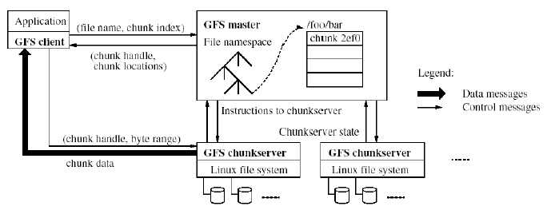
GFS architecture

Slide 39
Architecture of HDFS

Slide 40
Namenode and Datanodes
Master/slave architecture
HDFS cluster consists of a single Namenode, a master server that manages the file system namespace, Metadata and regulates access to files by clients.
There are a number of DataNodes usually one per node in a cluster.
The DataNodes manage storage attached to the nodes that they run on.
HDFS exposes a file system namespace and allows user data to be stored in files.
A file is split into one or more blocks and set of blocks are stored in DataNodes.
DataNodes: serves read, write requests, performs block creation, deletion, and replication upon instruction from Namenode.

Slide 41
HDFS Architecture
Namenode
Metadata(Name, replicas..)
(/home/foo/data,6. ..
Metadata ops
Client
Block ops
Read
Datanodes
Datanodes
B
replication
Blocks
Rack1
Write
Rack2
Client

Slide 42
File system Namespace
Hierarchical file system with directories and files
Create, remove, move, rename etc.
Namenode maintains the file system
Any meta information changes to the file system recorded by the Namenode.
An application can specify the number of replicas of the file needed: replication factor of the file. This information is stored in the Namenode.

Slide 43
Fault tolerance
Failure is the norm rather than exception
Hadoop is designed to be deployed on low-cost hardware by default, a hardware failure in this system is considered to be common rather than an exception.
Hadoop considers the following issues to fulfill reliability requirements of the file system
Block replication
Replica placement
Heartbeat and Blockreport messages

Slide 44
Fault tolerance
Block replication
HDFS stores a file as a set of blocks and each block is replicated and distributed across the whole cluster.
The replication factor is set by the user and is three by default.
Replica placement
Although storing replicas on different nodes (DataNodes) located in different racks across the whole cluster provides more reliability, it is sometimes ignored as the cost of communication between two nodes in different racks is relatively high
Sometimes HDFS compromises its reliability to achieve lower communication costs.
Stores one replica in the same node the original data is stored, one replica on a different node but in the same rack, and one replica on a different node in a different rack to provide three copies of the data

Slide 45
Replica Placement
The placement of the replicas is critical to HDFS reliability and performance.
Optimizing replica placement distinguishes HDFS from other distributed file systems.
Rack-aware replica placement:
Goal: improve reliability, availability and network bandwidth utilization
Research topic
Many racks, communication between racks are through switches.
Network bandwidth between machines on the same rack is greater than those in different racks.
Namenode determines the rack id for each DataNode.
Replicas are typically placed on unique racks
Simple but non-optimal
Writes are expensive
Replication factor is 3
Another research topic?
Replicas are placed: one on a node in a local rack, one on a different node in the local rack and one on a node in a different rack.
1/3 of the replica on a node, 2/3 on a rack and 1/3 distributed evenly across remaining racks.

Slide 46
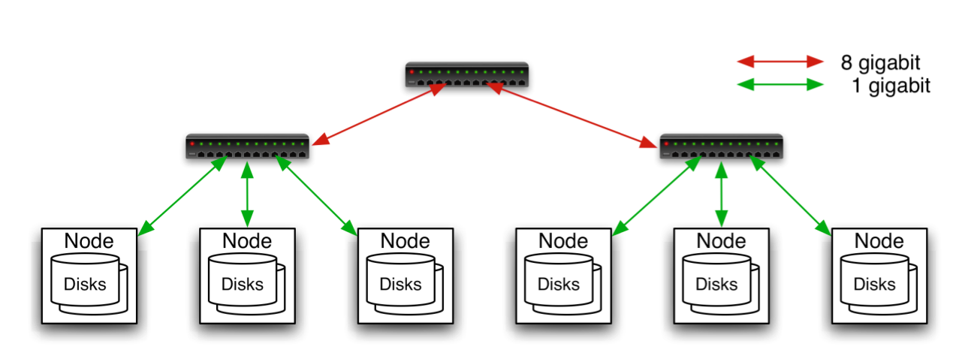
Replica Placement
Aggregation switch
Rack switch

Slide 47
Replica Selection
Replica selection for READ operation: HDFS tries to minimize the bandwidth consumption and latency.
If there is a replica on the Reader node then that is preferred.
HDFS cluster may span multiple data centers: replica in the local data center is preferred over the remote one.

Slide 48
Fault tolerance
Heartbeat and Blockreport messages
Heartbeats and Block reports are periodic messages sent to the NameNode by each DataNode in a cluster for every 3 seconds.
Receipt of a Heartbeat implies that the DataNode is functioning properly, while each Blockreport contains a list of all blocks on a DataNode.
The NameNode receives such messages because it is the sole decision maker of all replicas in the system.

Slide 49
HDFS High-Throughput Access to Large Data Sets (Files)
HDFS is primarily designed for batch processing rather than interactive processing data access throughput in HDFS is more important than latency
Individual files are broken into large blocks (e.g., 64 MB) to allow HDFS to decrease the amount of metadata storage required per file.
2 Advantages
List of blocks per file will shrink as the size of individual blocks increases
Keeping large amounts of data sequentially within a block, HDFS provides fast streaming reads of data.

Slide 50
Streaming Data
Streaming access enables data to be transferred in the form of a steady and continuous stream.
This means if data from a file in HDFS needs to be processed, HDFS starts sending the data as it reads the file and does not wait for the entire file to be read.
The client who is consuming this data starts processing the data immediately, as it receives the stream from HDFS.
This makes data processing really fast.
Write-once-read-many: a file once created, written and closed need not be changed – this assumption simplifies coherency. No Data Appending as in GFS

Slide 51
HDFS Operations

Slide 52
Writing a file into HDFS
Writing files in HDFS
To write a file in HDFS, a user sends a “create” request to the NameNode to create a new file in the file system namespace.
If the file does not exist, the NameNode notifies the user and allows him to start writing data to the file by calling the write function.
The first block of the file is written to an internal queue termed the data queue while a data streamer monitors its writing into a DataNode.
Since each file block needs to be replicated by a predefined factor, the data streamer first sends a request to the NameNode to get a list of suitable DataNodes to store replicas of the first block.
The steamer then stores the block in the first allocated DataNode.
Afterward, the block is forwarded to the second DataNode by the first DataNode.
The process continues until all allocated DataNodes receive a replica of the first block from the previous DataNode.
Once this replication process is finalized, the same process starts for the second block and continues until all blocks of the file are stored and replicated on the file system.

Slide 53
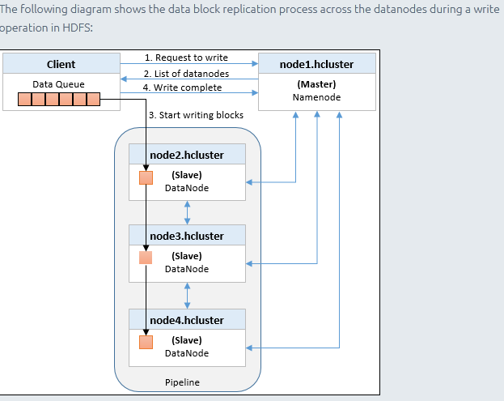
Writing Data into HDFS

Slide 54
Reading a file from HDFS
Reading files from HDFS
To read a file in HDFS, a user sends an “open” request to the NameNode to get the location of file blocks.
For each file block, the NameNode returns the address of a set of DataNodes containing replica information for the requested file.
The number of addresses depends on the number of block replicas.
Upon receiving such information, the user calls the read function to connect to the closest DataNode containing the first block of the file.
After the first block is streamed from the respective DataNode to the user, the established connection is terminated
The same process is repeated for all blocks of the requested file until the whole file is streamed to the user.

Slide 55
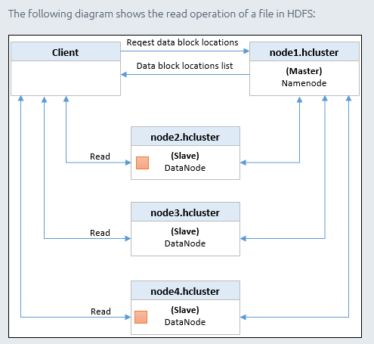
Reading Data from HDFS

Slide 56
Architecture of Hadoop

Slide 57
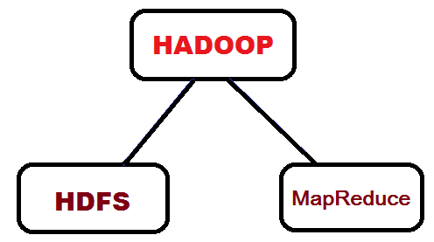
Hadoop Architecture

Slide 58
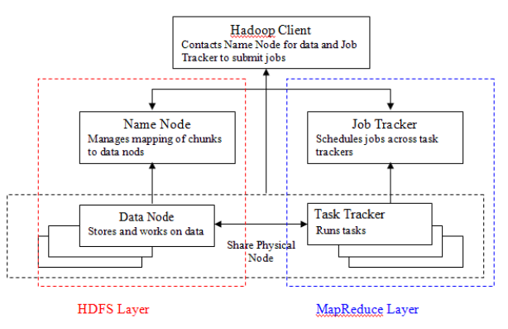
Hadoop Architecture

Slide 59
Hadoop Components
Distributed file system (HDFS)
Single namespace for entire cluster
Replicates data 3x for fault-tolerance
MapReduce framework
Executes user jobs specified as “map” and “reduce” functions
Manages work distribution & fault-tolerance

Slide 60
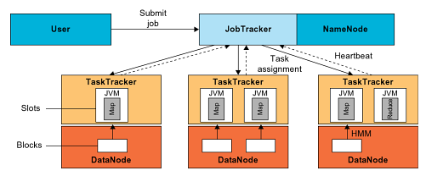
Hadoop Architecture

Slide 61
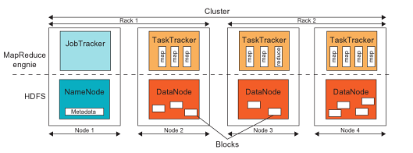
HDFS and MapReduce in Hadoop
Notes:
Cloud applications are the key global opportunity for developers during next four years
2009: $8.5 billion
2013: $16.8 billion

Slide 62
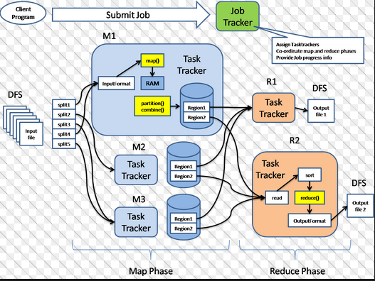
Hadoop Architecture

Slide 63
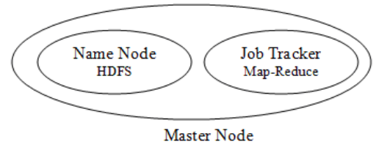
Hadoop Architecture
These functions are handled by two different nodes:
Name Node: helps in coordinating HDFS
Job Tracker: helps in coordinating parallel execution of Map-Reduce

Slide 64
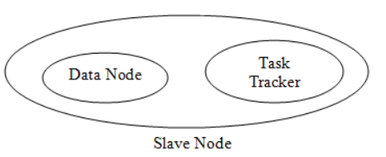
Hadoop Architecture
Slave node consists of Data Node and Task Tracker.
There are number slave nodes in a Hadoop cluster.
These nodes communicate and receive instructions for the Master nodes and perform the assigned tasks.

Slide 65
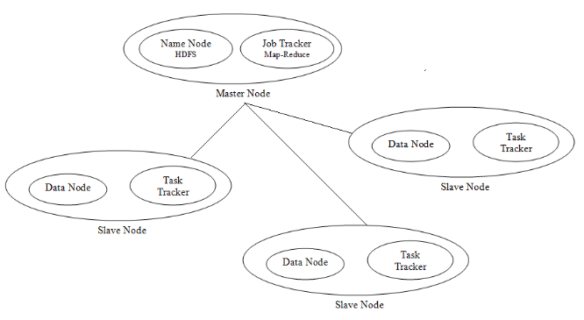
Hadoop Architecture

Slide 66
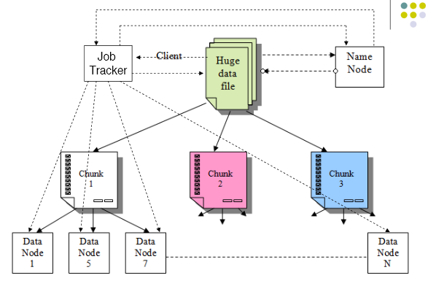
Hadoop Working

Slide 67
Name Node and Data Node
Name Node is a critical component of the HDFS.
Responsible for the distribution of the data throughout the Hadoop cluster.
Obtains the data from client machine divides it in to chunks.
Distributes same data chunk to three different data nodes leading to data redundancy
Keeps track of What chucks belong to a file and which Data Node holds its copy.
Making sure each chunk of file has the minimum number of copies in the cluster as required.
Directs clients for write or read operation
Schedule and execute Map Reduce jobs
One slave act as secondary NameNode
Data Node
Responsible to store the chunk of data that assigned to it by the Name Node.

Slide 68
Job Tracker and Task Tracker
Job Tracker
Client submitted Map-Reduce logic.
Responsible for scheduling the task to the slave nodes.
Job Tracker consults the Name Node and assigns the task to the nodes which has the data on which this task would be performed
Locality of data is checked for assigning a Map function to a node (Task Tracker), whereas Reduce function does not need locality of data.
One Task Tracker may act as secondary Job Tracker
Task Tracker
Has the actual logic to perform the task.
Performs the task (Map and reduce functions) on the data assigned to it by Master Node.

Slide 69
Typical Hadoop Cluster
Aggregation switch
Rack switch
40 nodes/rack, 1000-4000 nodes in cluster
1 Gbps bandwidth within rack, 8 Gbps out of rack
Node specs (Yahoo terasort): 8 x 2GHz cores, 8 GB RAM, 4 disks (= 4 TB?)
Image from http://wiki.apache.org/hadoop-data/attachments/HadoopPresentations/attachments/YahooHadoopIntro-apachecon-us-2008.pdf

Slide 70
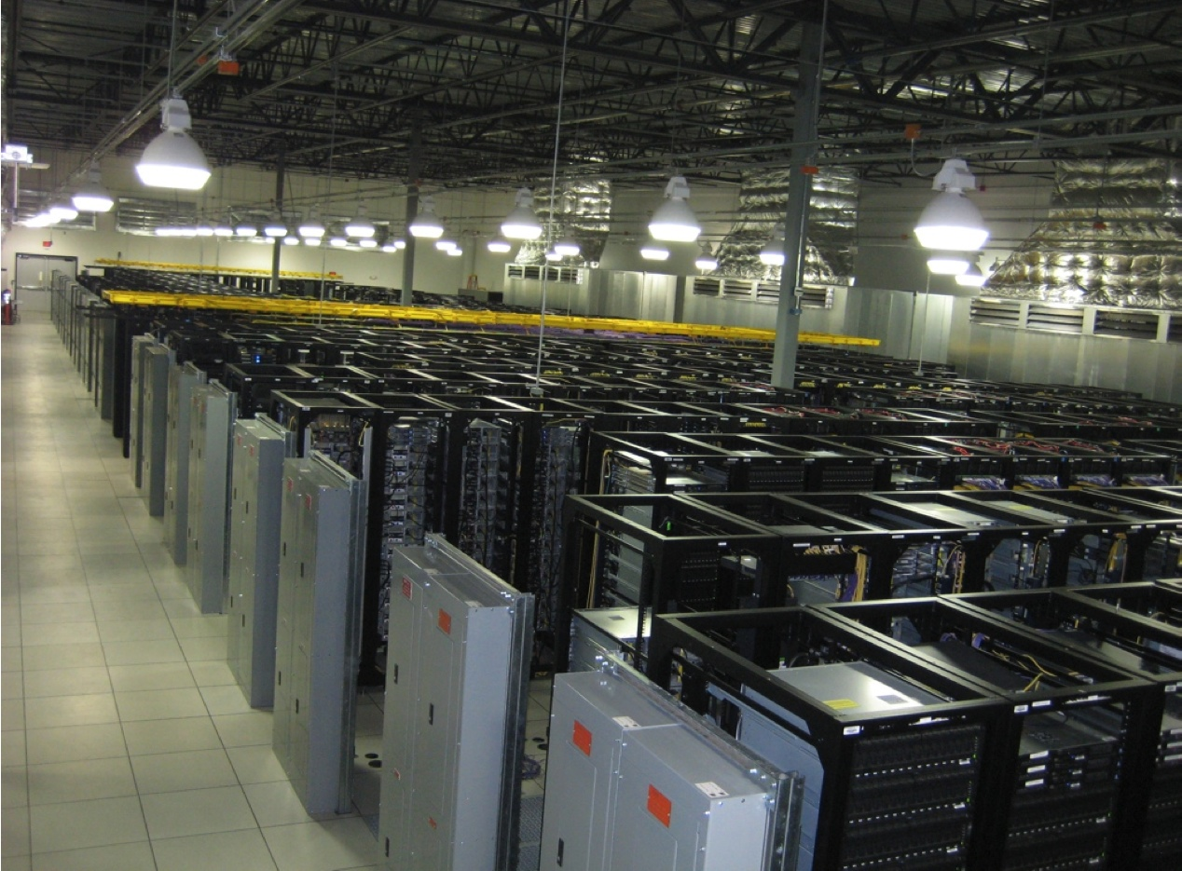
Typical Hadoop Cluster
Image from http://wiki.apache.org/hadoop-data/attachments/HadoopPresentations/attachments/aw-apachecon-eu-2009.pdf

Slide 71
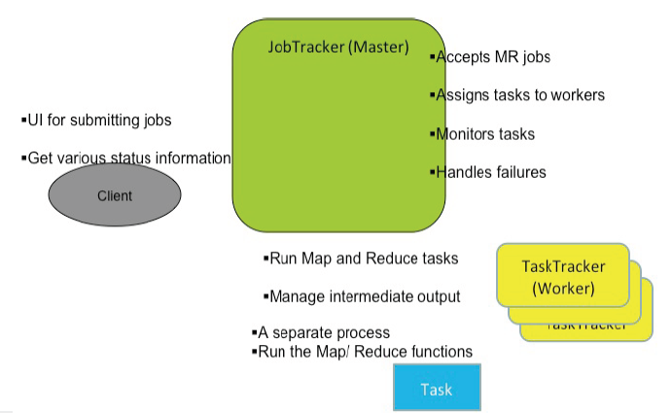
MapReduce Architecture

Slide 72
Running a Job in Hadoop
Job Submission
Task assignment
Task execution
Task running check

Slide 73
Running a Job in Hadoop
Job Submission
Each job is submitted from a user node to the JobTracker node
A user node asks for a new job ID from the JobTracker and computes input file splits
The user node copies some resources, such as the job’s JAR file, configuration file, and computed input splits, to the JobTracker’s file system
The user node submits the job to the JobTracker by calling the submitJob() function

Slide 74
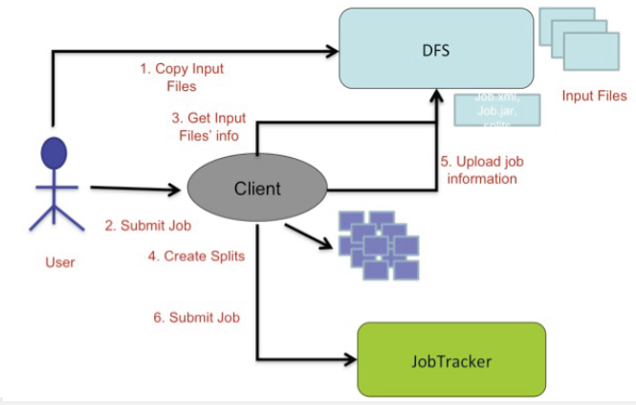
Job Submission

Slide 75
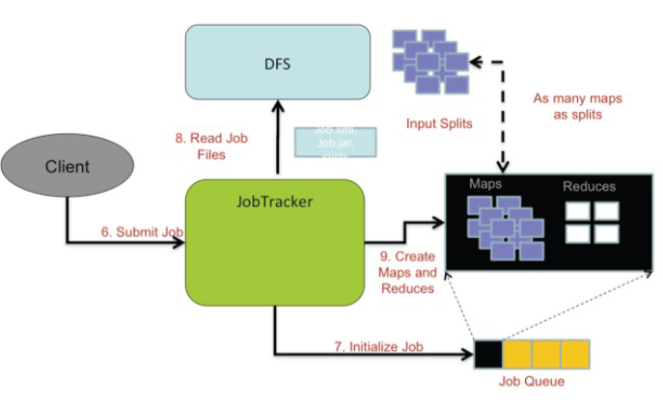
Job Initialization

Slide 76
Running a Job in Hadoop
Task Assignment
The JobTracker creates one map task for each computed input split by the user node and assigns the map tasks to the execution slots of the TaskTrackers
The JobTracker considers the localization of the data when assigning the map tasks to the TaskTrackers.
The JobTracker also creates reduce tasks and assigns them to the TaskTrackers
The number of reduce tasks is predetermined by the user.
There is no locality consideration in assigning them.

Slide 77
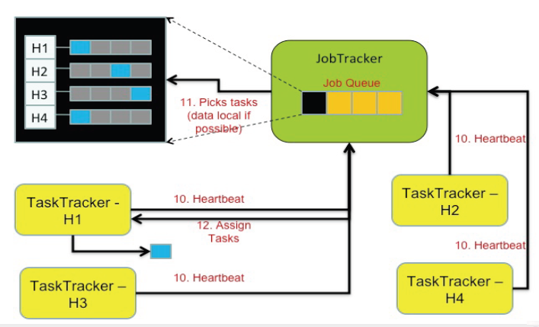
Job Scheduling

Slide 78
Running a Job in Hadoop
Task Execution
The control flow to execute a task (either map or reduce) starts inside the TaskTracker by copying the job JAR file to its file system.
Instructions inside the job JAR file are executed after launching a Java Virtual Machine (JVM) to run its map or reduce task.

Slide 79
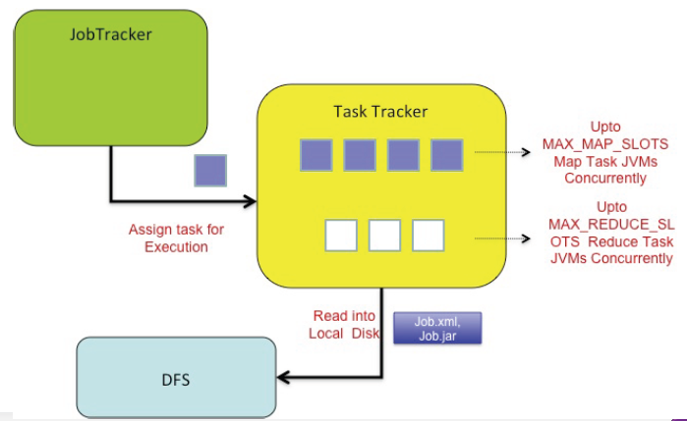
Job Execution (Map Task)

Slide 80
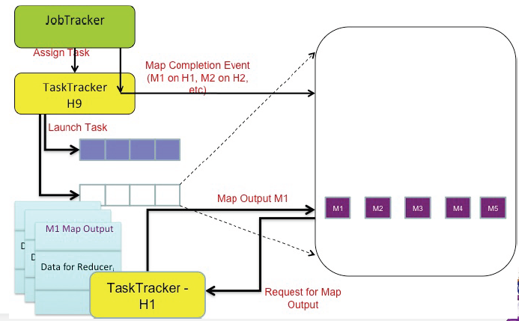
Job Execution (Reduce Task)

Slide 81
Running a Job in Hadoop
Task running check
A task running check is performed by receiving periodic heartbeat messages to the JobTracker from the TaskTrackers.
Each heartbeat notifies the JobTracker that the sending TaskTracker is alive, and whether the sending TaskTracker is ready to run a new task.

Slide 82
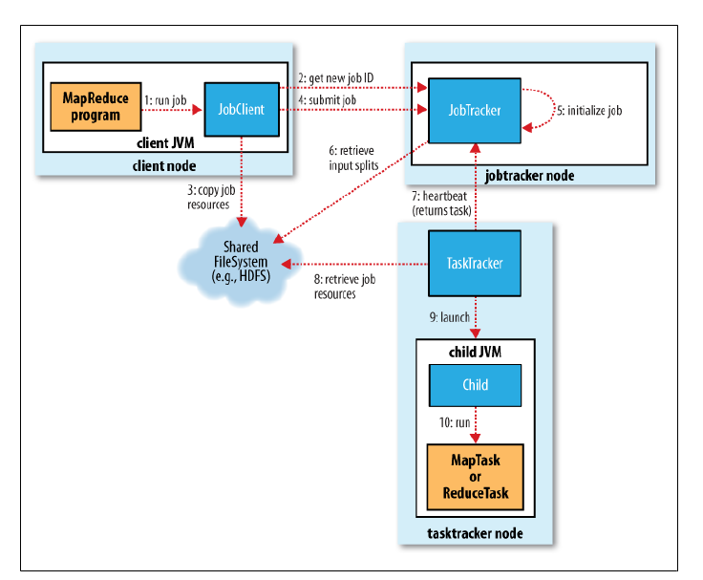
How Hadoop runs a MapReduce job?

Slide 83
Challenges
Cheap nodes fail, especially if you have many
Mean time between failures for 1 node = 3 years
Mean time between failures for 1000 nodes = 1 day
Solution: Build fault-tolerance into system
Commodity network = low bandwidth
Solution: Push computation to the data
Programming distributed systems is hard
Solution: Data-parallel programming model: users write “map” & “reduce” functions, system distributes work and handles faults

Slide 84
Summary
Process flow in MapReduce
Motivation for Programming Paradigm
MapReduce
MapReduce Operational Steps
Twister : Iterative MapReduce
Hadoop
HDFS Architecture
Read and Write Operations in HDFS
MapReduce Architecture in Hadoop
Running a job in Hadoop
Challenges

Slide 85
References
Hadoop: http://hadoop.apache.org/core/
http://hadoop.apache.org/docs/r1.2.1/hdfs_design.html
https://www.packtpub.com/books/content/hdfs-and-mapreduce

Slide 86
Thank You

